Slide 1
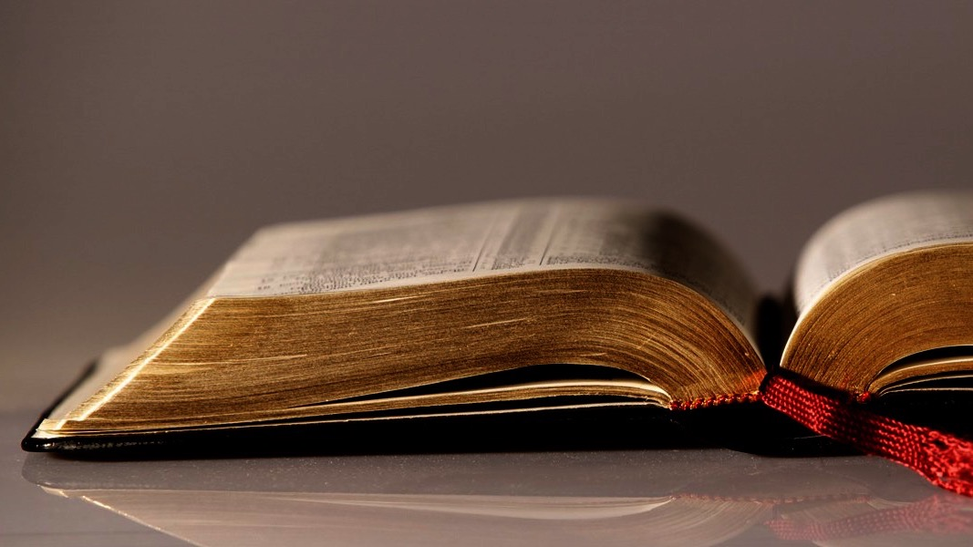
Welcome to
Our Sunday School
We’ll start at 9:07
visit OurSundaySchool.com for more about our class

Slide 2
Today’s class: Philemon introduction
“Introduction” of the handout
Brief history of Colossae
Brief history of the Colossian church
Preparing for Philemon 1:1–14

Slide 3
Today’s class: Philemon introduction
“Introduction” of the handout
Brief history of Colossae
Brief history of the Colossian church
Preparing for Philemon 1:1–14

Slide 4

Visitors: loan you
a copy for today
Members: get a
print edition
Online: visit OurSundaySchool.com

Slide 5
“Introduction” of the handout
Class vote on what color this is
Midnight blue
Navy
You can’t make me care about that

Slide 6
Page 2: About Our Sunday School
Fully knowing an infinite God is impossible, but we will strive to as he is worth the effort.
May this resource help us to experience, know, and enjoy God— so we can make him known with our words and works.
Christen Barber Harper

Slide 7
Page 5: About Our Sunday School

Slide 8
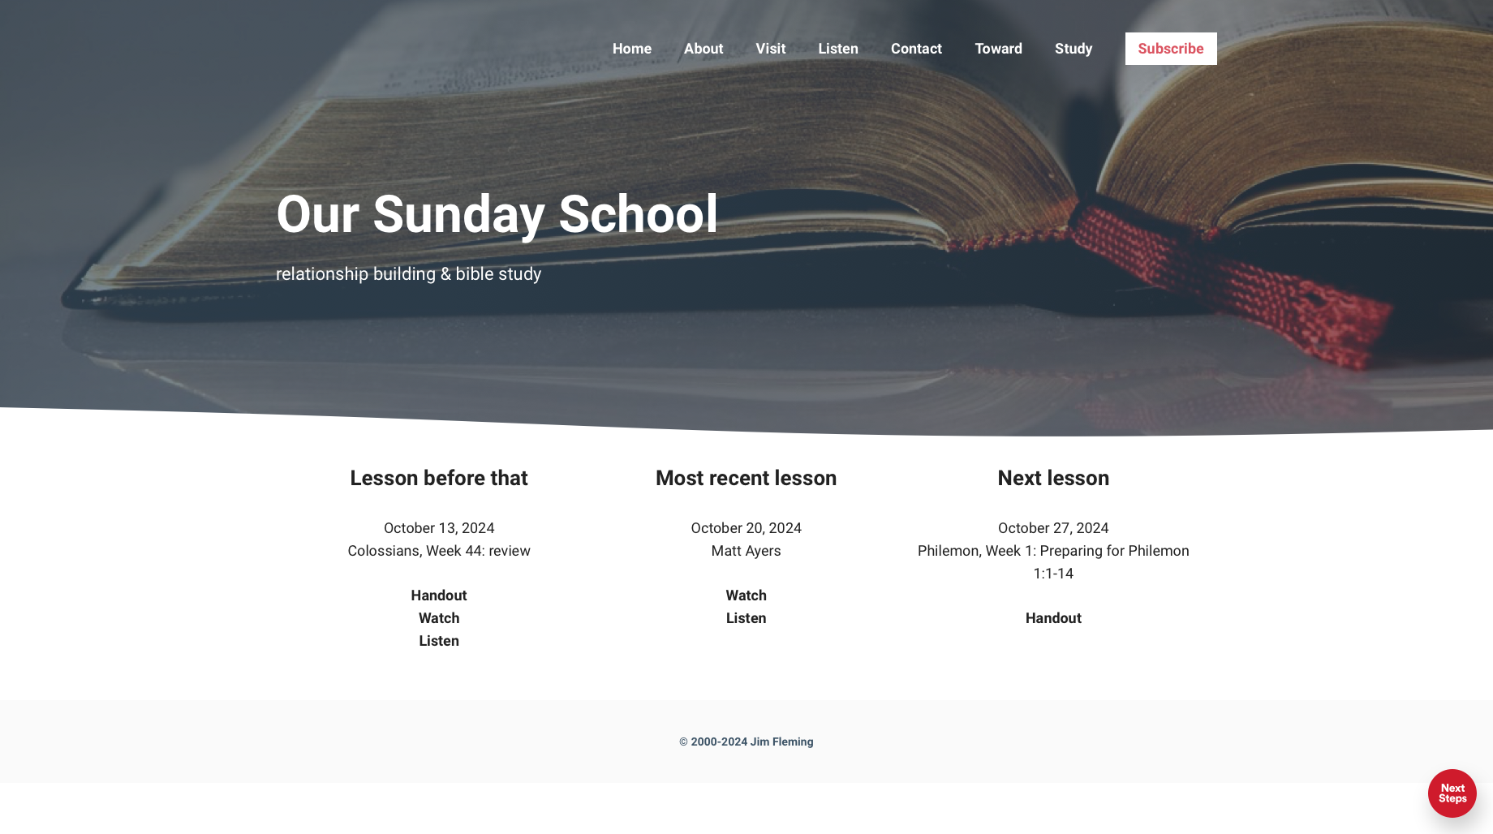

Slide 9
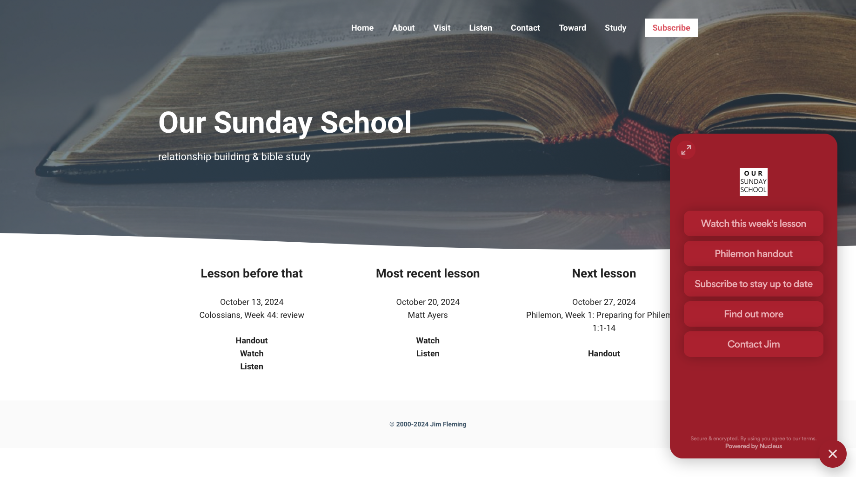

Slide 10
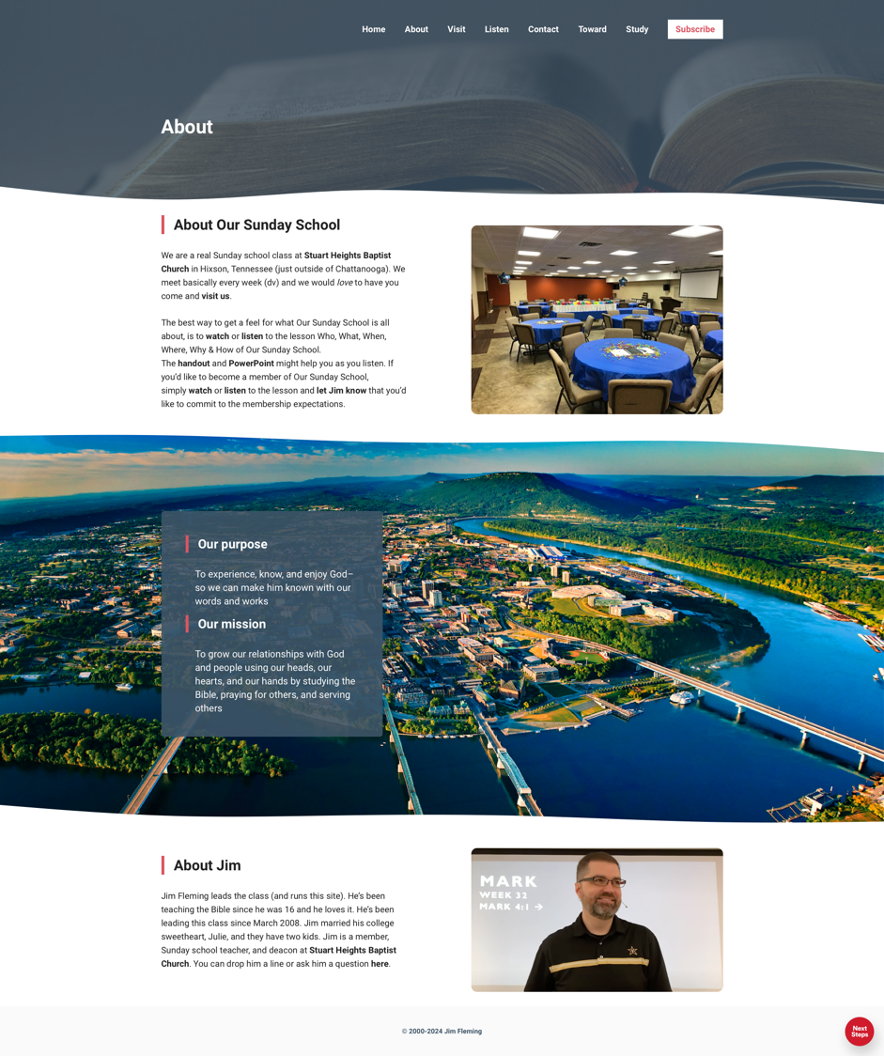

Slide 11
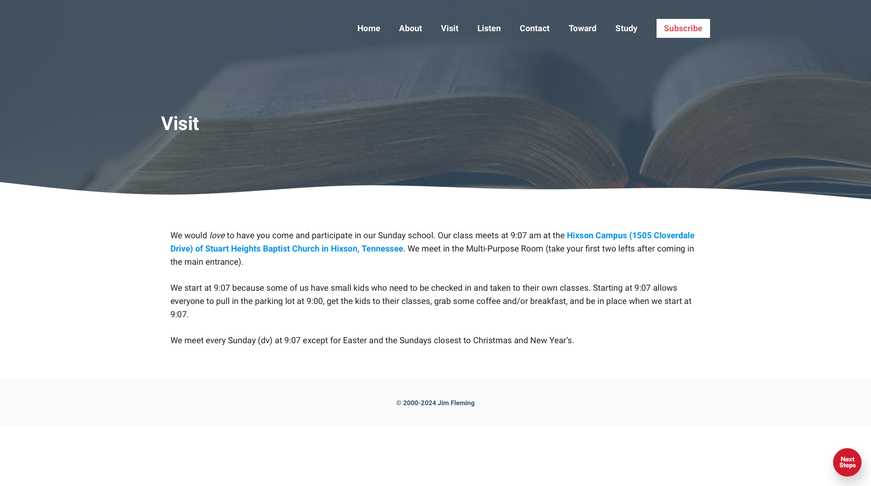

Slide 12
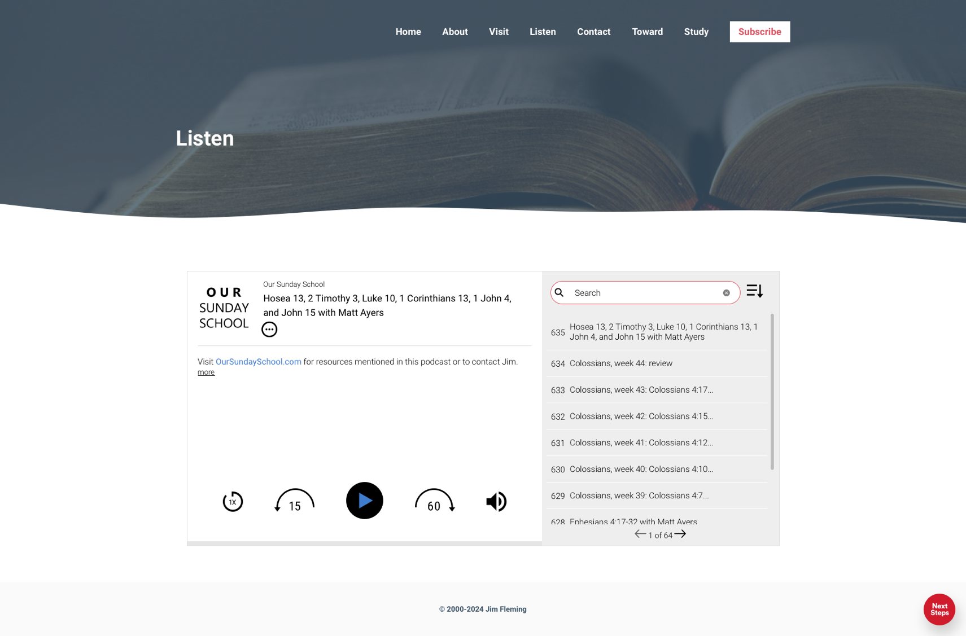

Slide 13
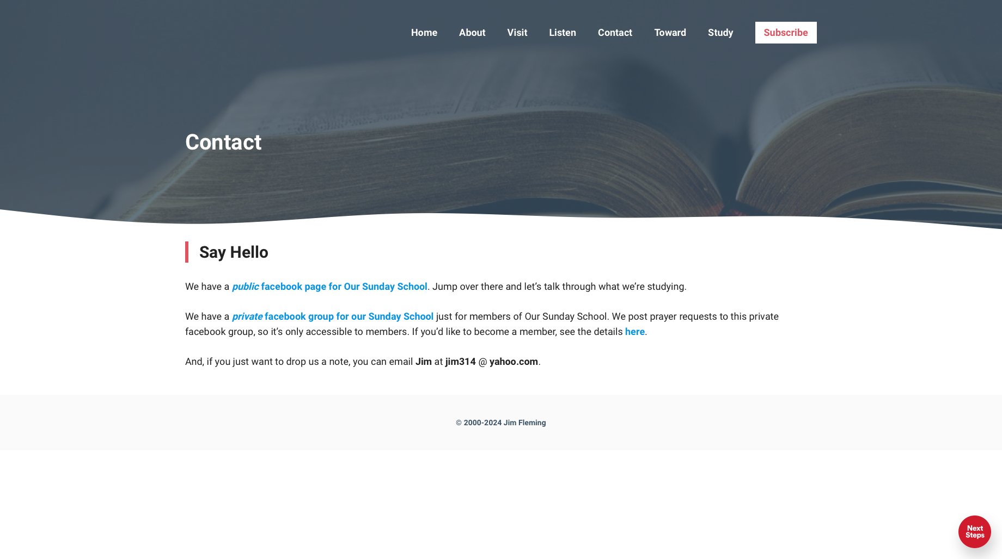

Slide 14
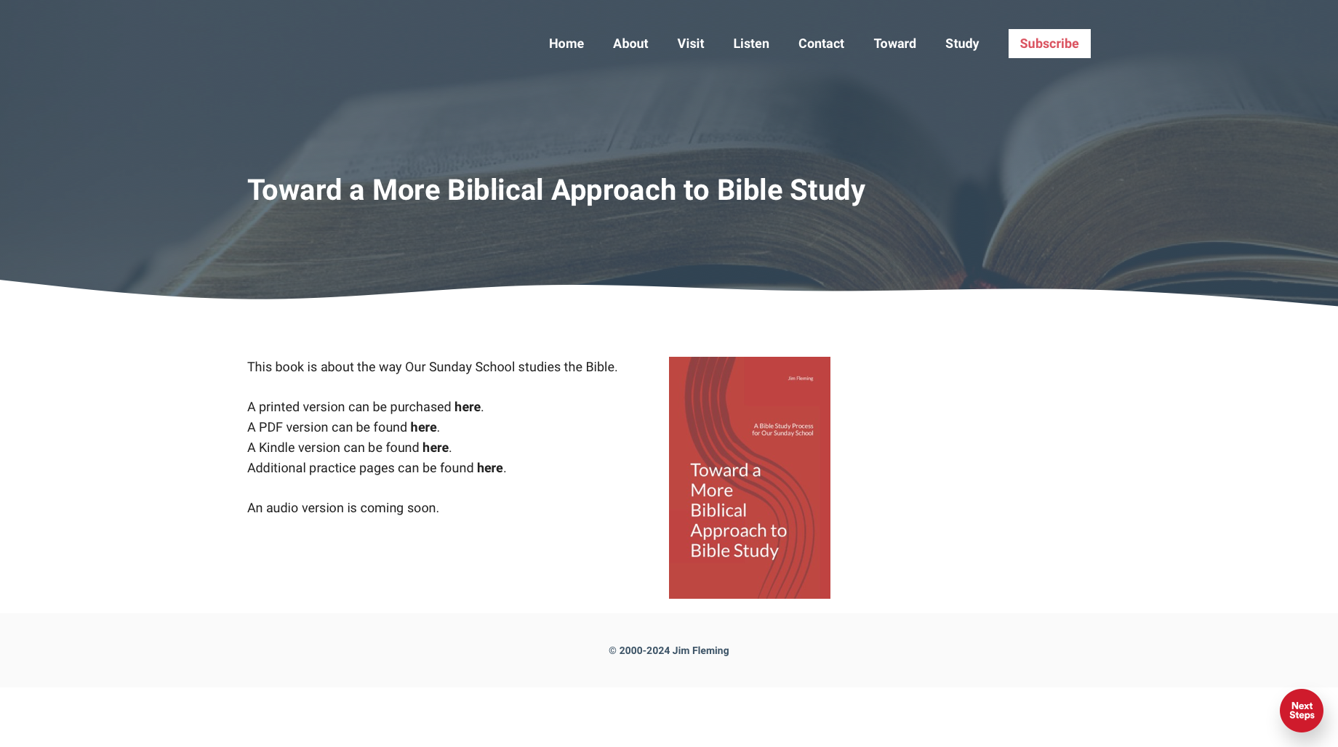

Slide 15
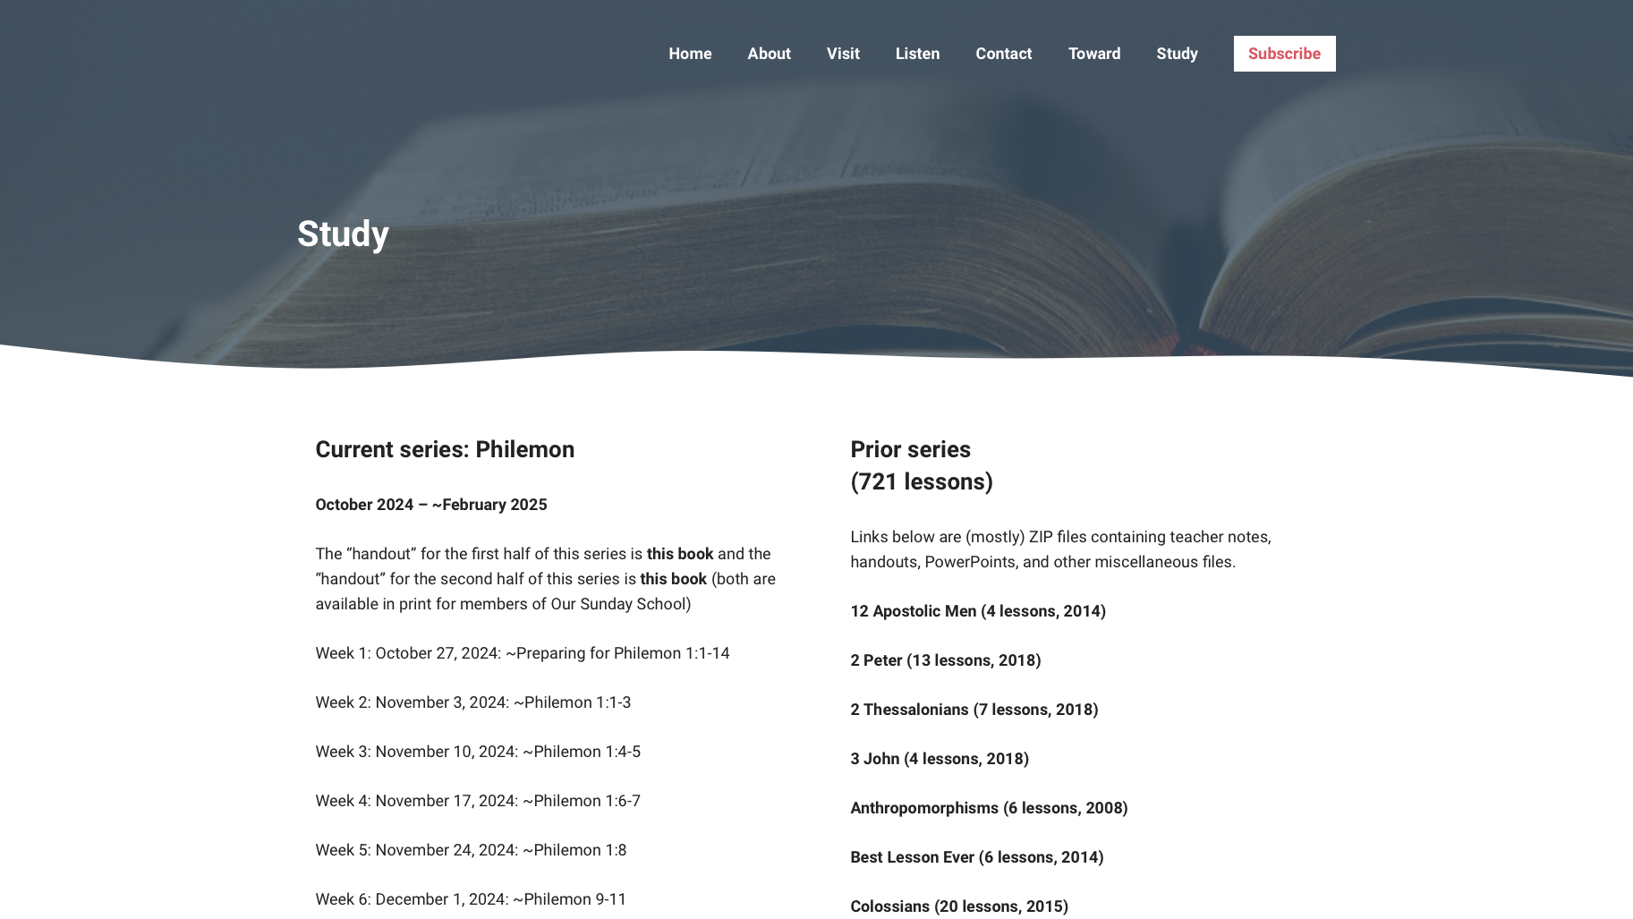

Slide 16
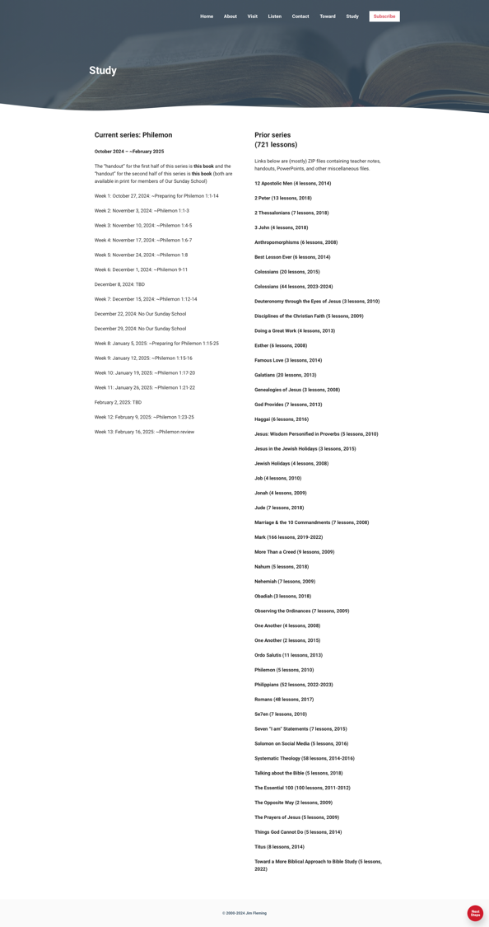

Slide 17
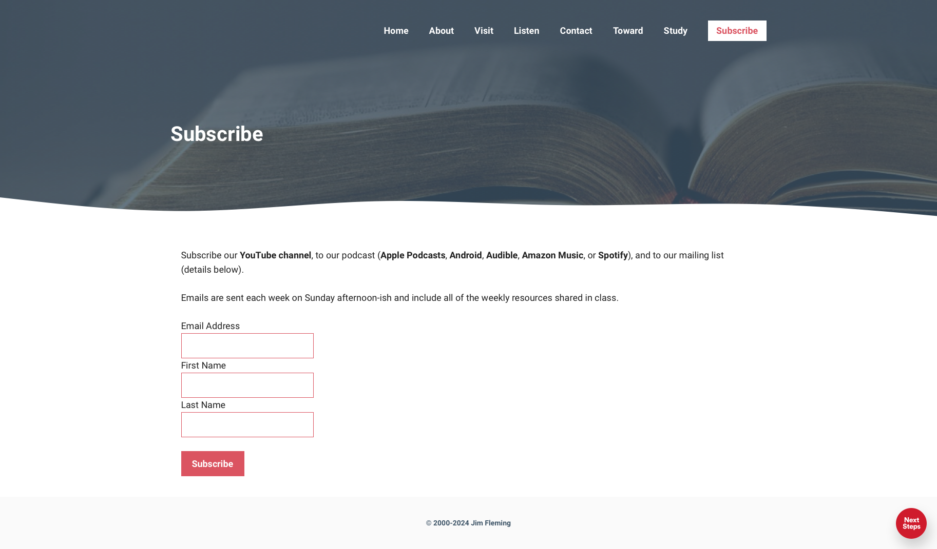

Slide 18
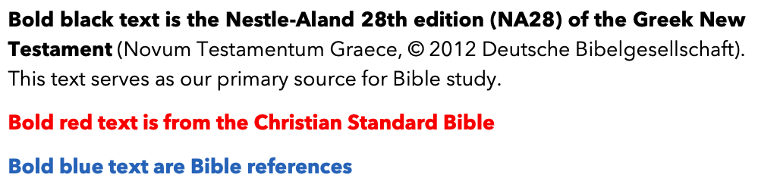
Page 6: About This Resource

Slide 19
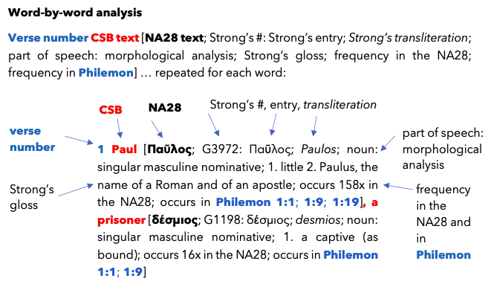
Page 7: About This Resource

Slide 20
Pages 7–8: Commentaries

Slide 21
Pages 9–13: Cheat Sheets for Greek

Slide 22
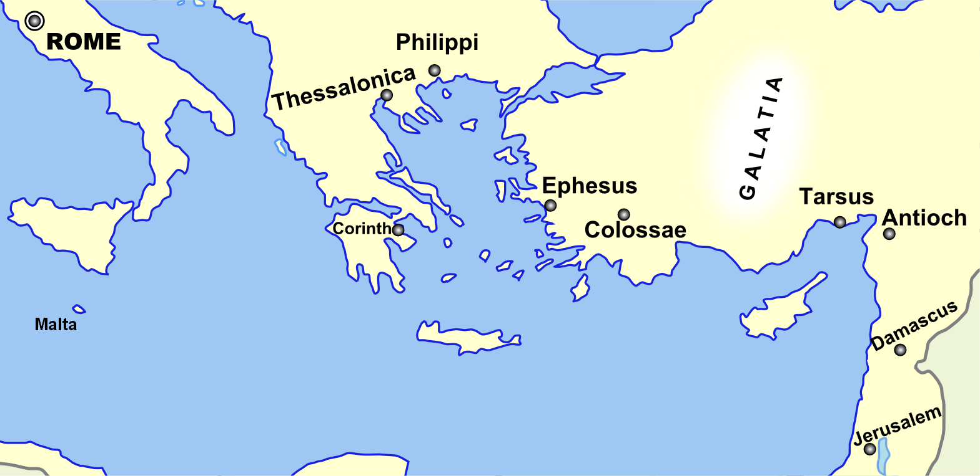
Page 14: Broad Overview of Geography
Monozigote. (2012). Broad Overview of Geography Relevant to
Paul of Tarsus [Map]. Wikipedia.

Slide 23
Today’s class: Philemon introduction
“Introduction” of the handout
Brief history of Colossae
Brief history of the Colossian church
Preparing for Philemon 1:1–14

Slide 24
Brief History of Colossae
Used to be a big deal
Had dwindled by the time of Paul
Known for its “fusion of religious influences” (Wikipedia)

Slide 25
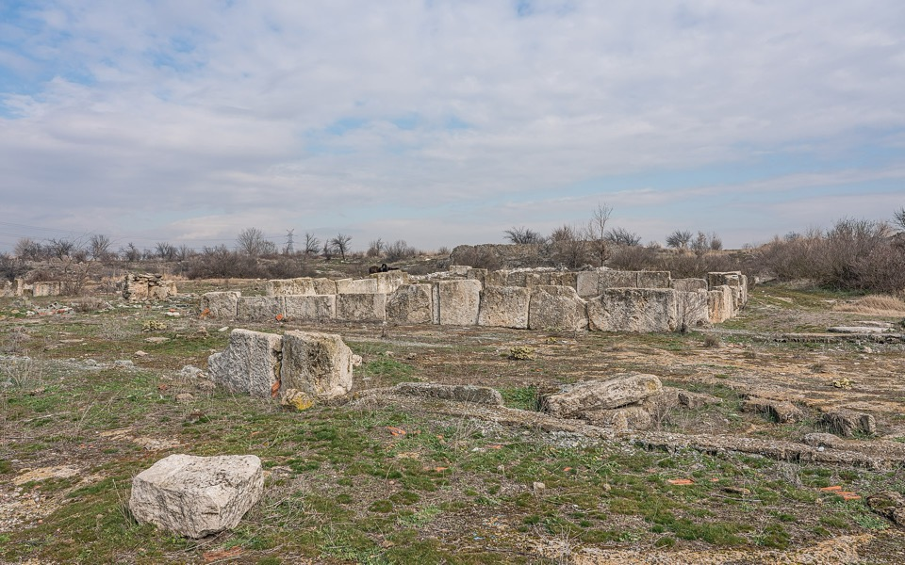
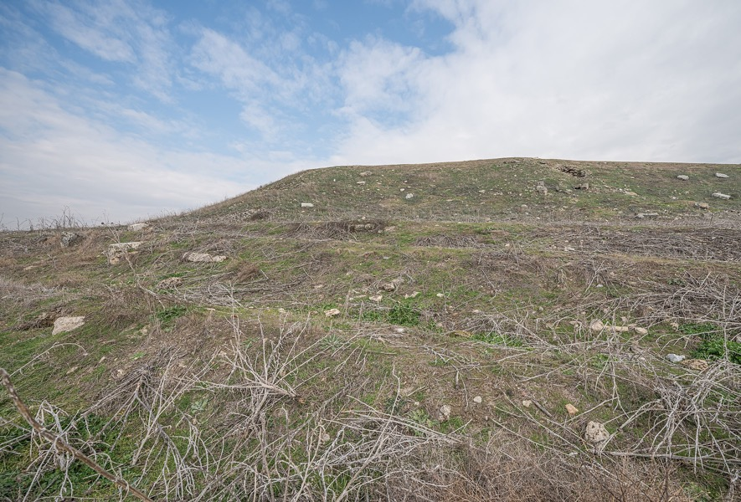
Colossae today
By A.Savin - Own work, FAL, https://commons.wikimedia.org/w/index.php?curid=87546204

Slide 26
Today’s class: Philemon introduction
“Introduction” of the handout
Brief history of Colossae
Brief history of the Colossian church
Preparing for Philemon 1:1–14

Slide 27
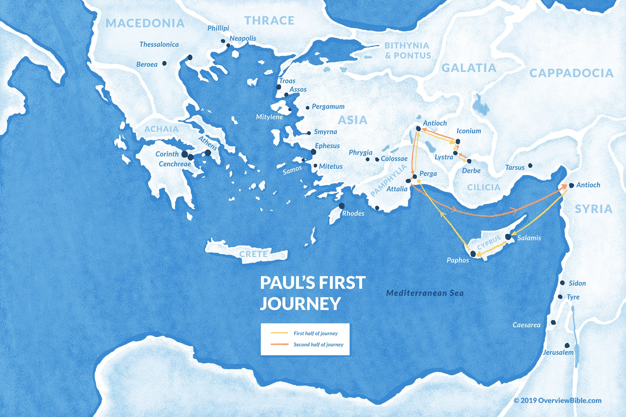
#1
~Acts
13
–
14

Slide 28
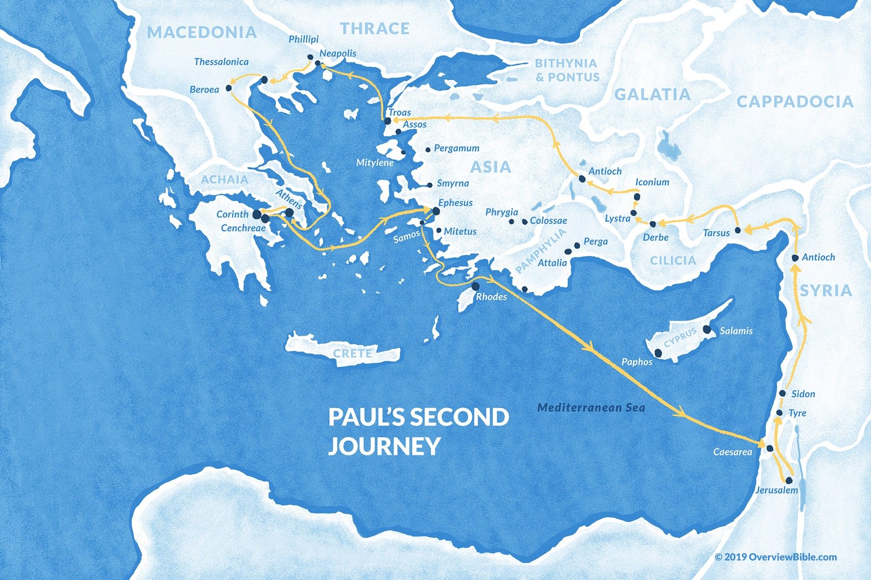
#2
~Acts
15:40 –
18:22

Slide 29
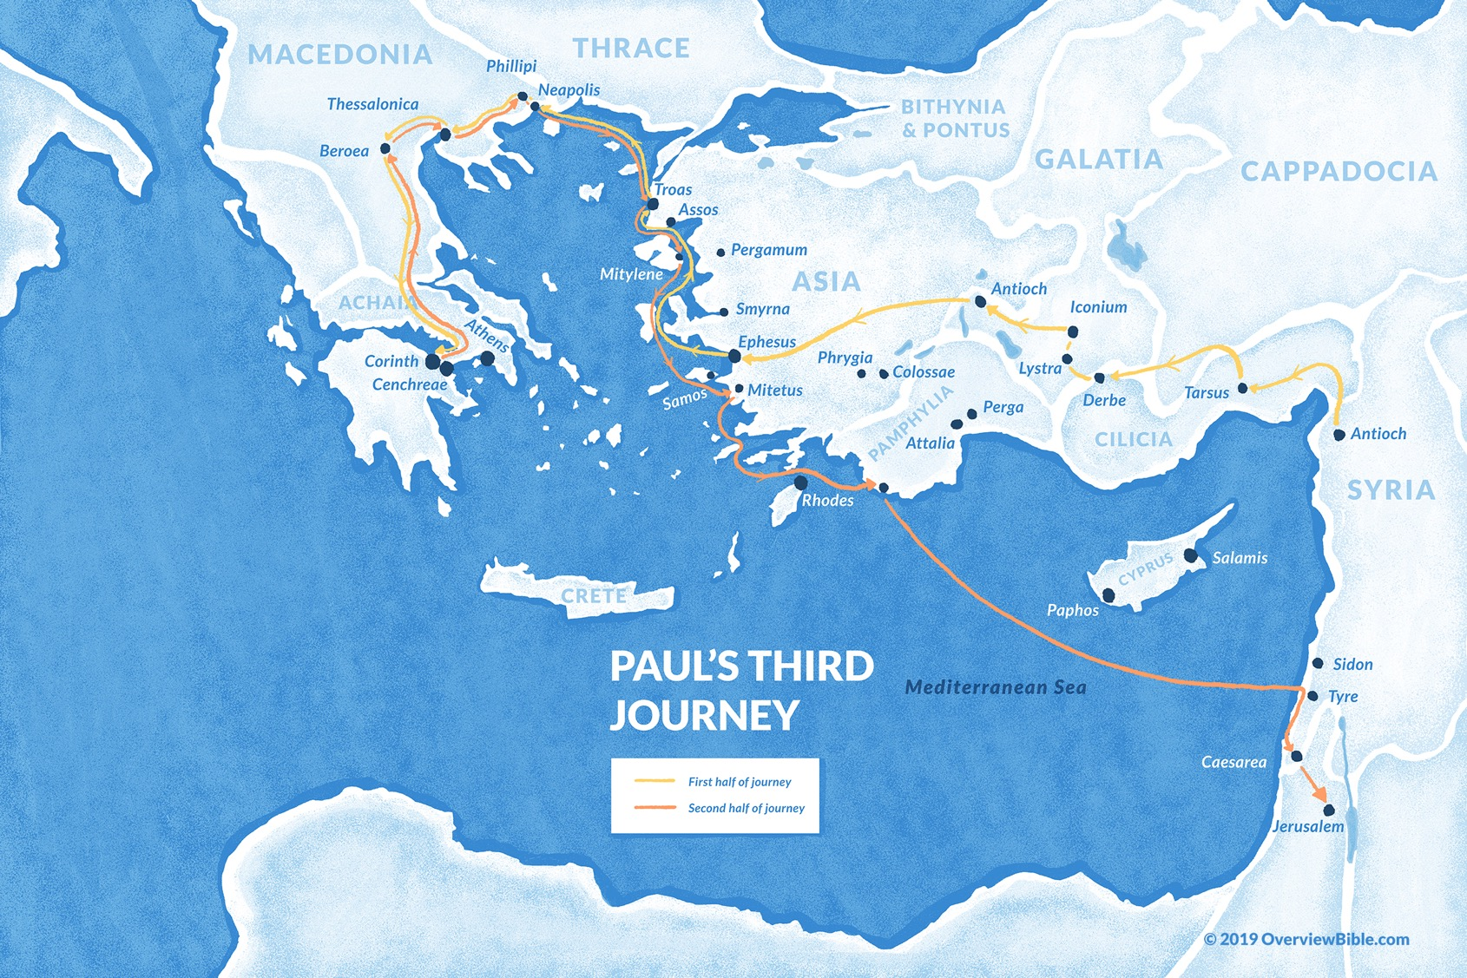
#3
~Acts 18:23 – 21:15
Colossae?
18:23 – 19:10

Slide 30
Today’s class: Philemon introduction
“Introduction” of the handout
Brief history of Colossae
Brief history of the Colossian church
Preparing for Philemon 1:1–14

Slide 31
Preparing for Philemon 1:1–14 (page 16)
Pray with others
Hear with others
Think with others
Study with others In class, as tables
Share with others
Invite others After class
  In class, as a class

Slide 32
Preparing for Philemon 1:1–14 (page 16)
Pray with others
Hear with others
Think with others
Study with others In class, as tables
Share with others
Invite others After class
  In class, as a class

Slide 33
Preparing for Philemon 1:1–14 (page 16)
Pray with others
Hear with others
Think with others
Study with others In class, as tables
Share with others
Invite others After class
  In class, as a class

Slide 34
Preparing for Philemon 1:1–14 (page 16)
Pray with others
Hear with others
Think with others
Study with others In class, as tables
Share with others
Invite others After class
  In class, as a class

Slide 35
Preparing for Philemon 1:1–14 (page 16)
Pray with others
Hear with others
Think with others
Study with others In class, as tables
Share with others
Invite others After class
  In class, as a class

Slide 36
Preparing for Philemon 1:1–14 (page 16)
Pray with others
Hear with others
Think with others
Study with others In class, as tables
Share with others
Invite others After class
  In class, as a class

Slide 37
Preparing for Philemon 1:1–14 (page 16)
Pray with others
Hear with others
Think with others
Study with others In class, as tables
Share with others
Invite others After class
  In class, as a class

Slide 38
Reminder: Commentaries
Quote are due to Jim by Thursday night
If you would like one, let Jim know

Slide 39
Prayer time
Write down your prayer requests (on the Weekly Update or in the comments
Lean in, engage, and pray for someone not with you
Be out of this room by 9:50
Go worship

Slide 40
Philemon: week X (pages X–XX)

Slide 41
Preparing for Philemon 1:1–14 (page 16)
Pray with others
Hear with others
Think with others
Study with others In class, as tables
Share with others
Invite others After class
  In class, as a class

Slide 42
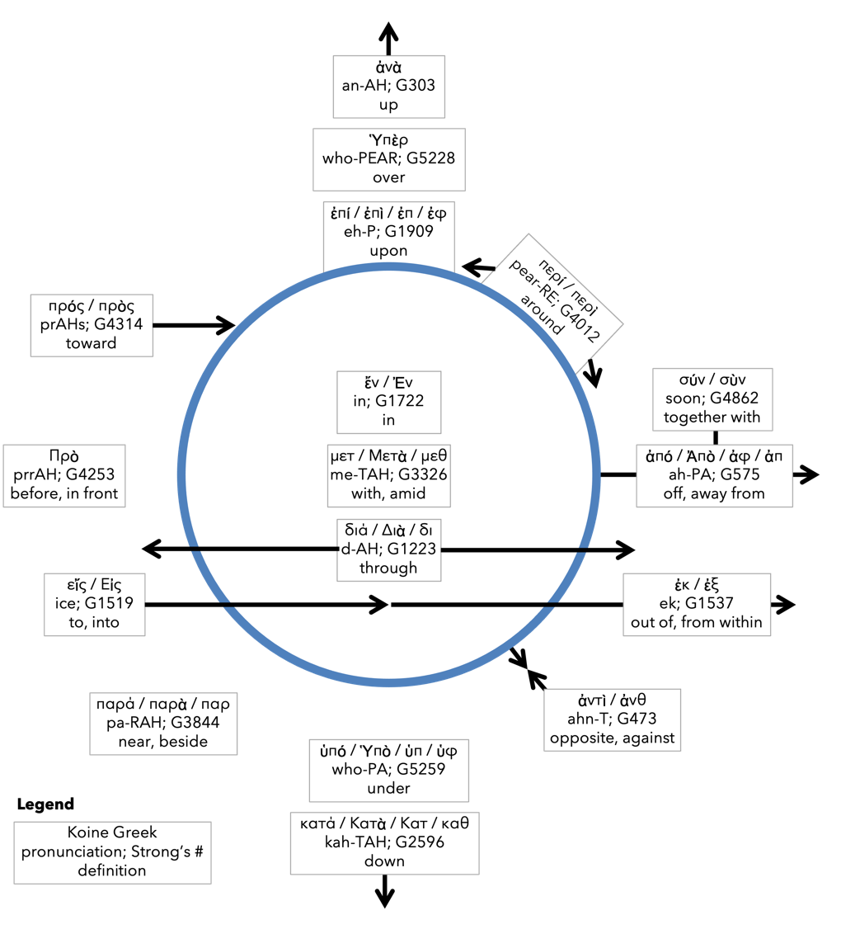
Preposition circle (page 11)

Slide 43

BDAG on morphe
(mor-FAY) definition

Slide 44
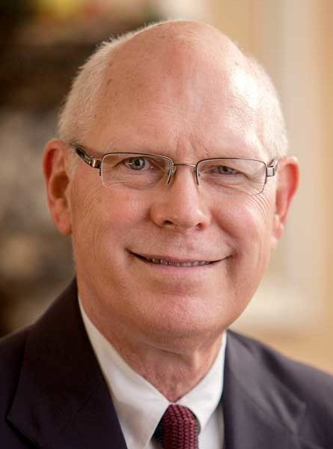
Dr. Gregory K. Beale
Quote

Slide 45
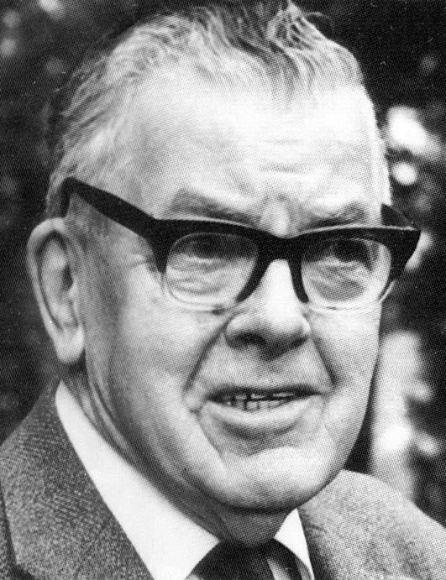
F. F. Bruce
Quote

Slide 46
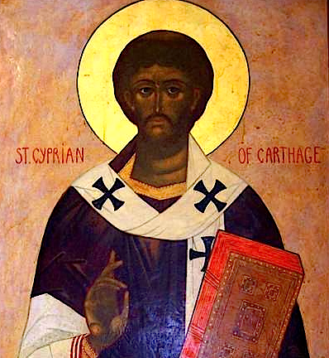
Cyprian
Quote

Slide 47
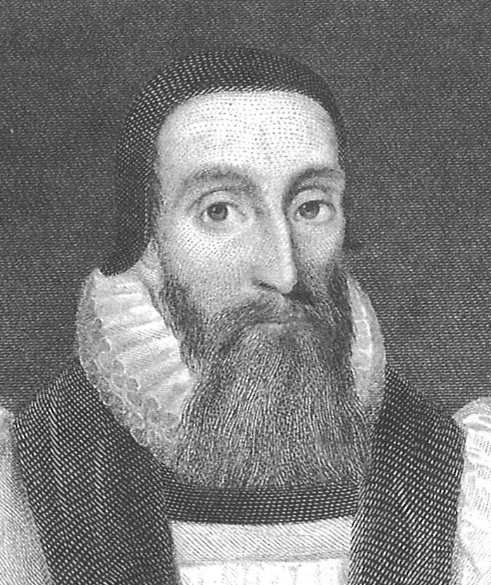
Dr. John Davenant
Quote

Slide 48
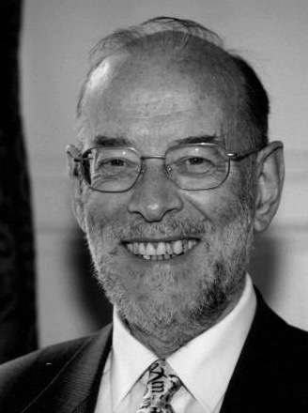
Dr. James D. G. Dunn
Quote

Slide 49
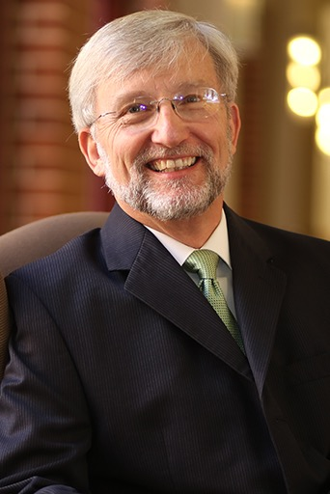
Dr. David Garland
Quote

Slide 50
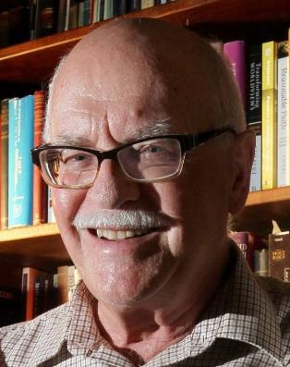
Dr. Murray J. Harris
Quote

Slide 51
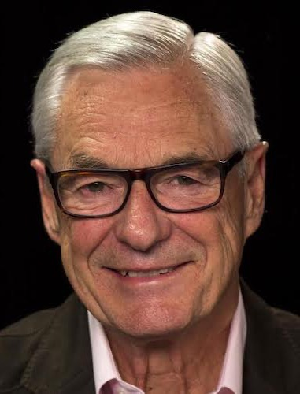
Dr. R. Kent Hughes
Quote

Slide 52
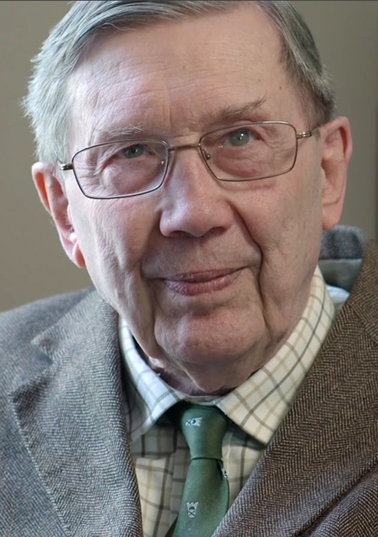
R. C. Lucas
Quote

Slide 53
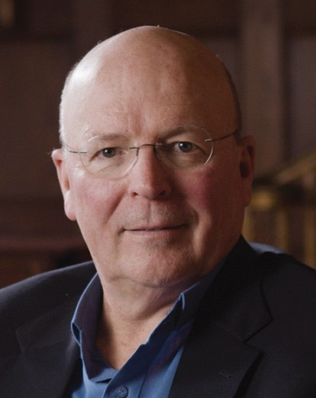
Dr. Scot McKnight
Quote

Slide 54
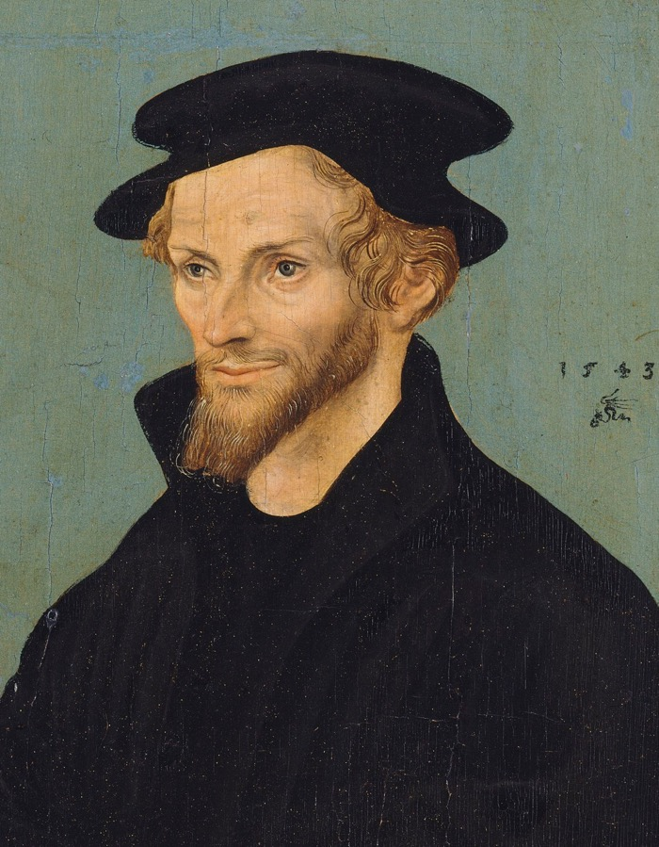
Philip Melanchthon
Quote

Slide 55
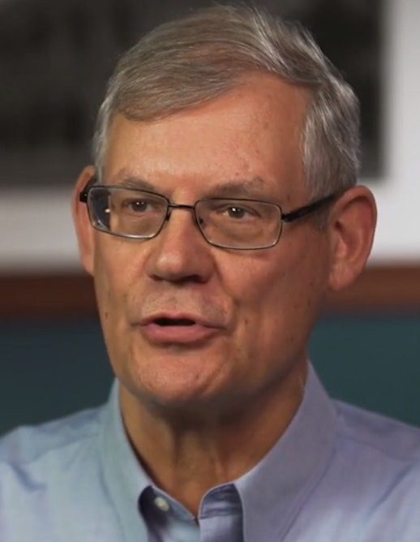
Dr. Douglas J. Moo
Quote

Slide 56
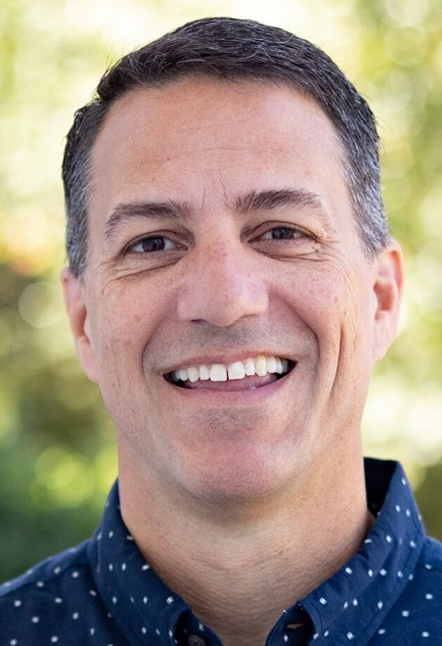
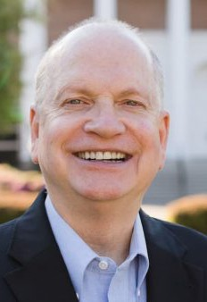
Dr. R. Scott Pace
& Dr. Daniel L. Akin
Quote

Slide 57
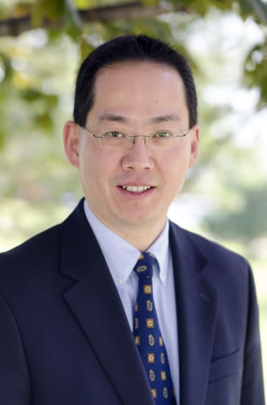
Dr. David W. Pao
Quote

Slide 58
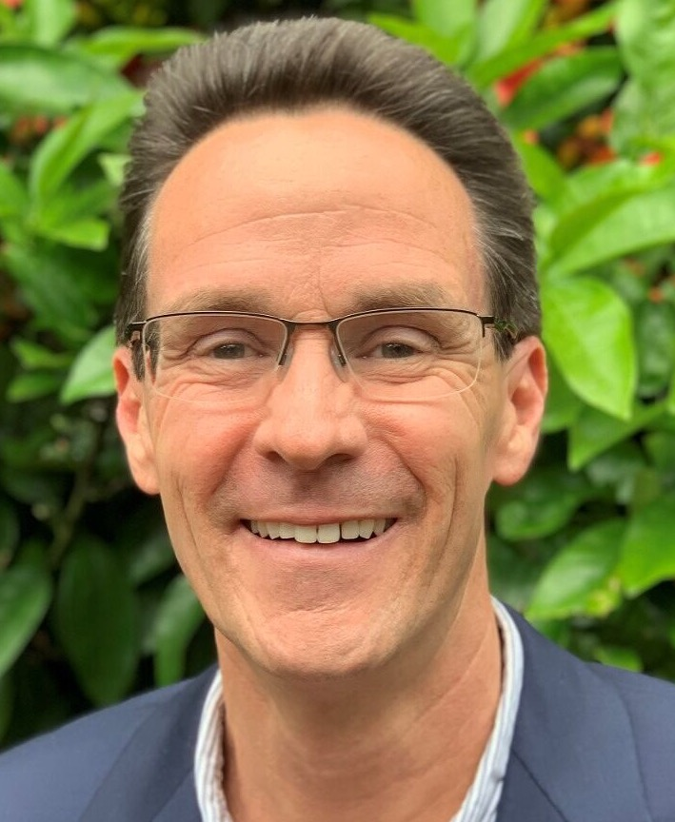
Dr. Alan Thompson
Quote

Slide 59
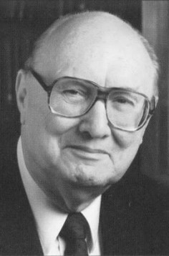
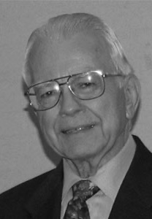
Dr. John F. Walvoord
& Dr. Roy B. Zuck
Quote

Slide 60
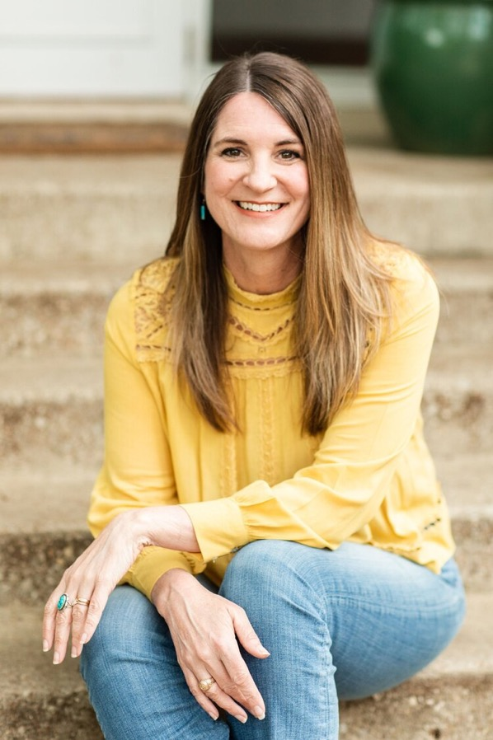
Jen Wilkin
Quote

Slide 61
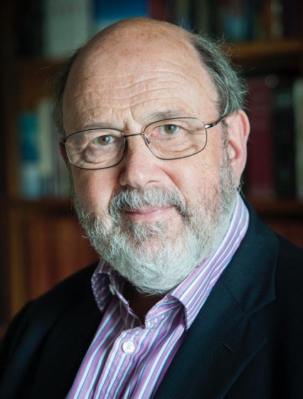
Dr. N. T. Wright
Quote

